Slide 1
Autonomous Vocal and Backing Track Mixing
Kelian (Mike) Li
Music Informatics Group

Slide 2
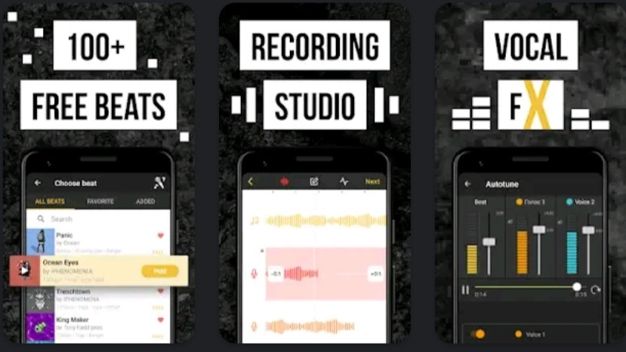
Motivation
Karaoke apps
Amateur music makers

Slide 3
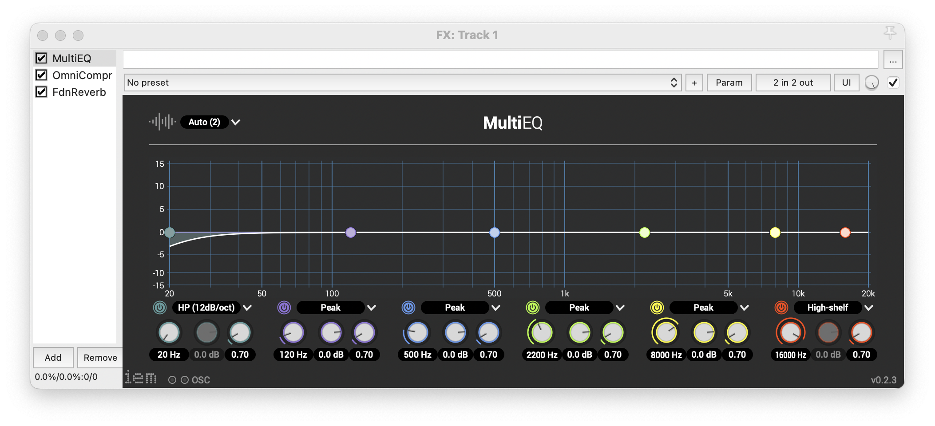
Audio Processing
EQ

Slide 4
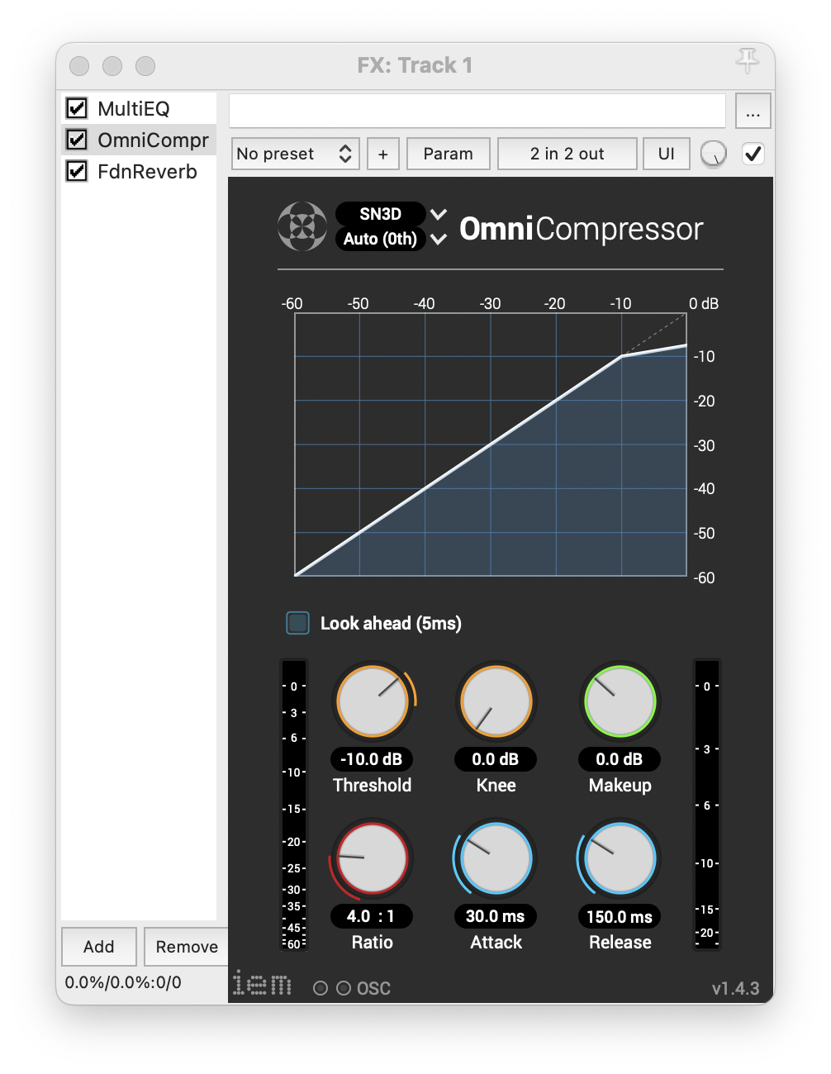
Audio Processing
EQ
Compression

Slide 5
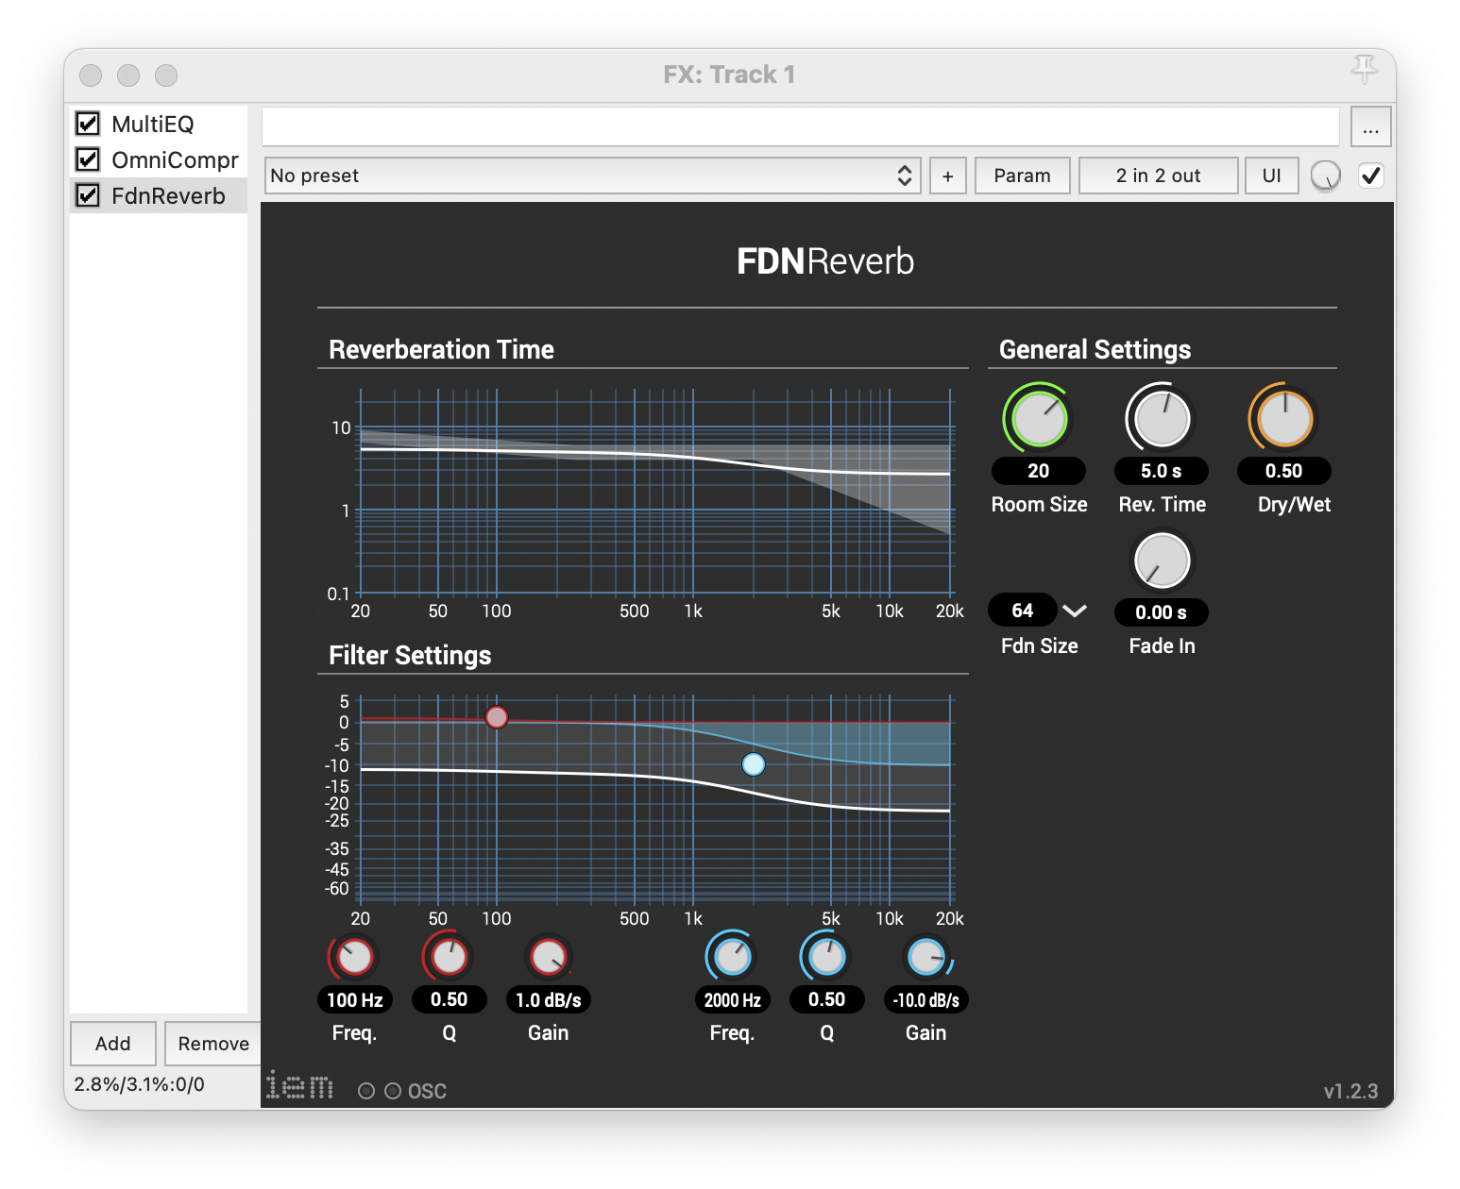
Audio Processing
EQ
Compression
Reverb

Slide 6
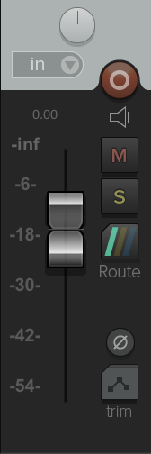
Audio Processing
EQ
Compression
Reverb
Level Balance

Slide 7
Baseline System: level and compression
Use the average values extracted from the source-separated Million Song Dataset
Level balance
-1.77 dB vocal-to-backing track ratio
Compression
16.4 dB loudness range

Slide 8
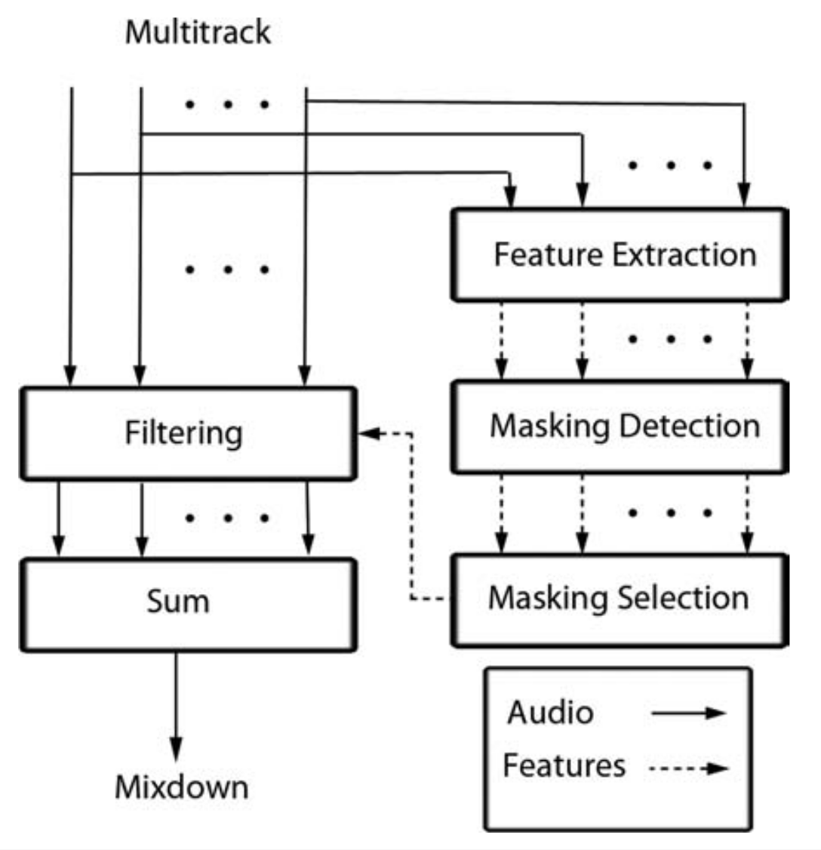
Baseline System: EQ
EQ
Frequency unmasking

Slide 9
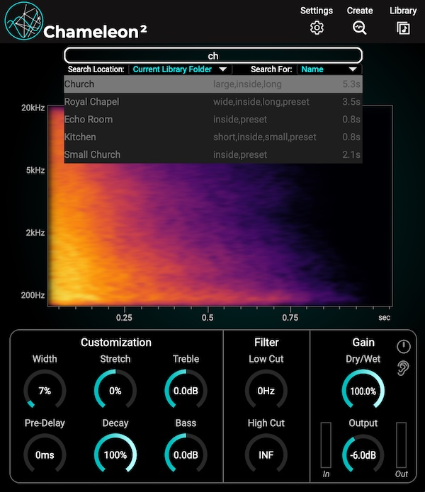
Rule-based System: reverb
Get the estimated impulse responses from the Chameleon plugin
Estimate the reverb parameters by the genetic algorithm
Use mean values extracted from the MUSDB18 train set
Reverb
Dry/wet ratio: 11.5%
Reverb time: Linear mapping from tempo
Room size: 14.54
Fade in time: 0.68 s

Slide 10
Data-driven System
Train a convolutional neural network to predict direct or intermediate mixing parameters based on the input audio
model input:
Mel-spectrogram of the vocal and the backing track

Slide 11
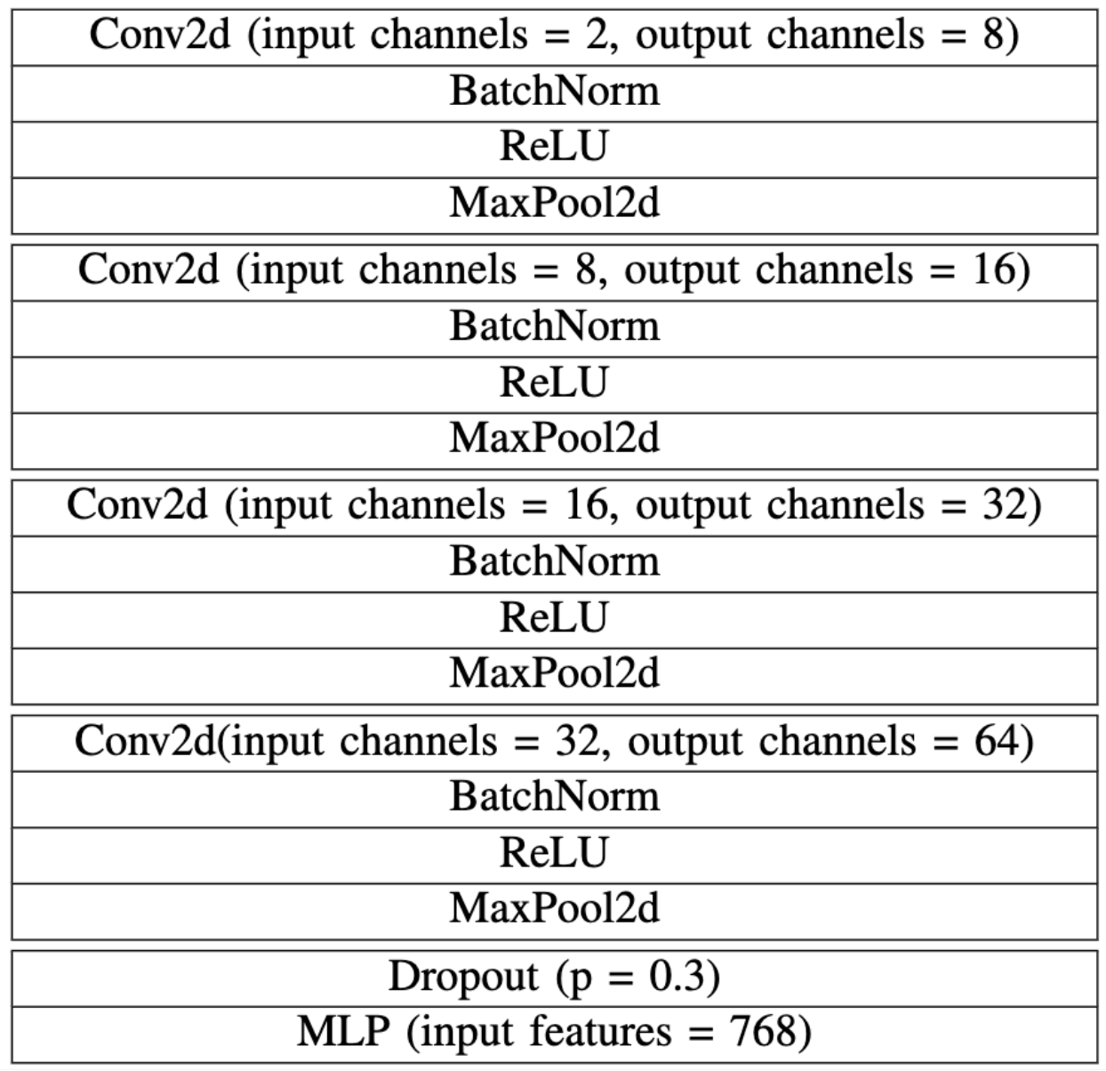
Data-driven System

Slide 12
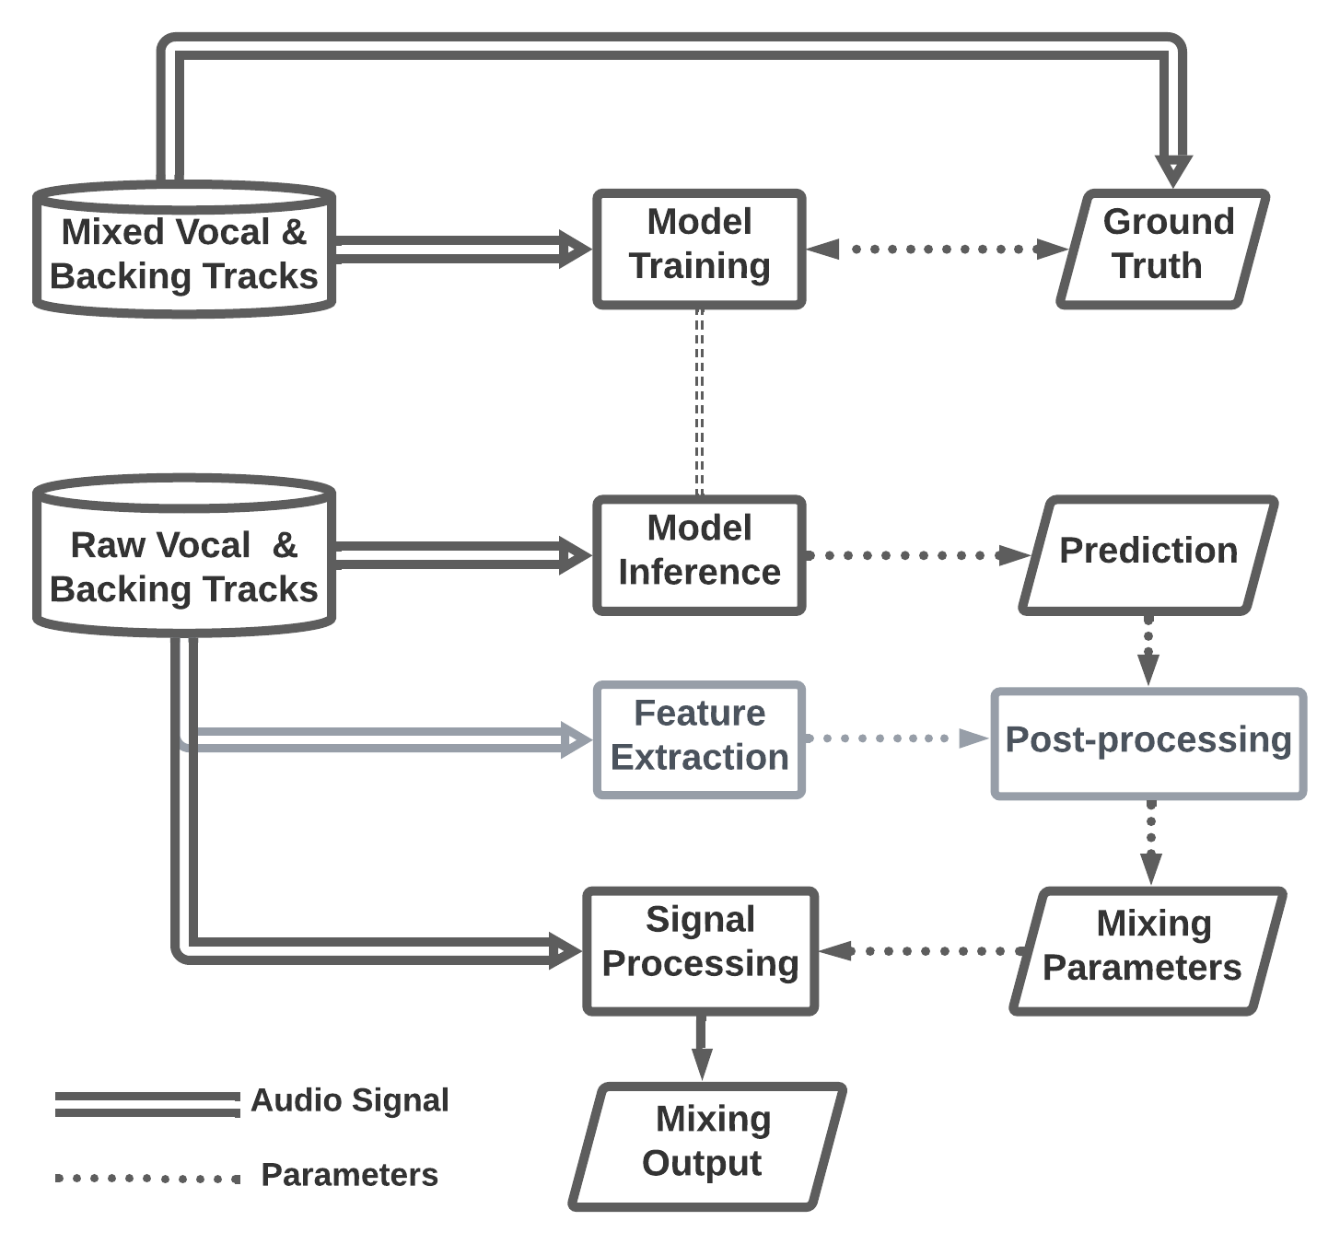

Model Training
Ground truth is the direct or intermediate mixing parameters
Optionally, convert intermediate model outputs into direct mixing parameters
Model Inference

Slide 13
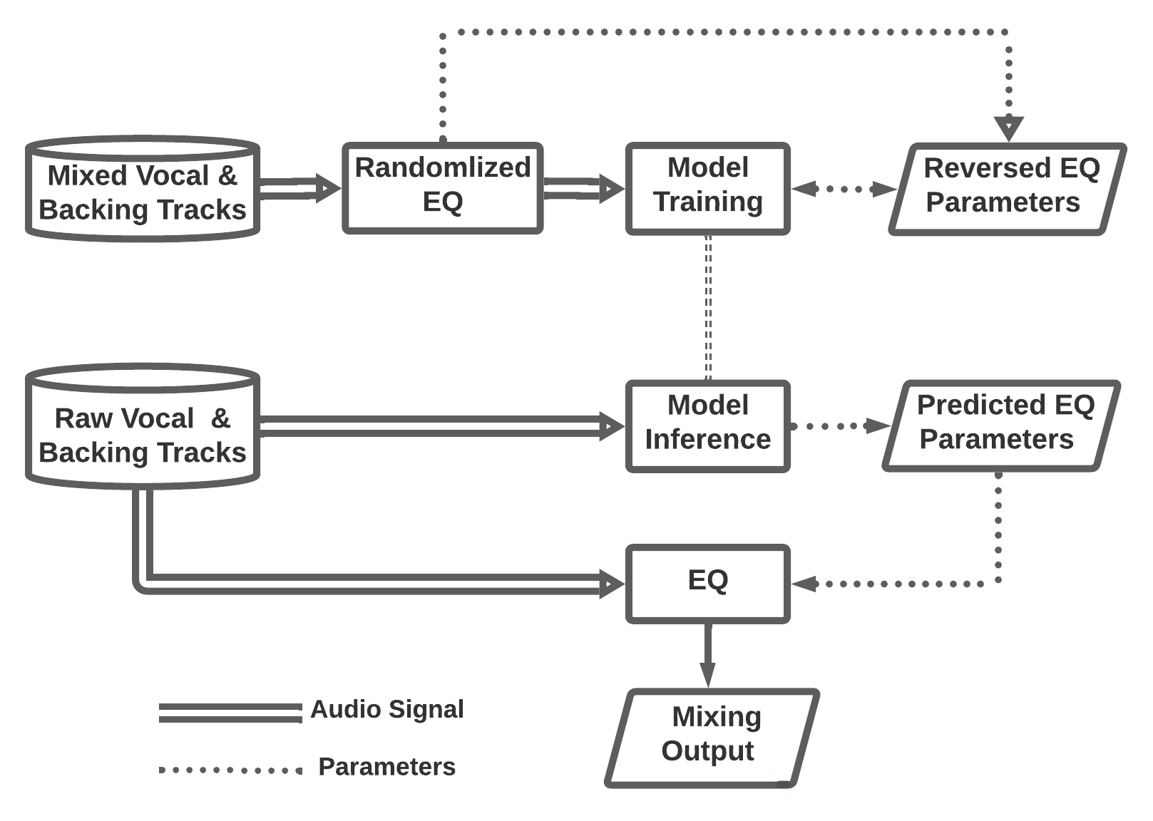
Data-driven System: EQ
Model Training
If the mixed vocal is boosted at a center frequency, we should learn to cut at that frequency.
Model Inference

Slide 14
Objective Evaluation
Validation on the MUSDB test set, 48 songs in total

Slide 15
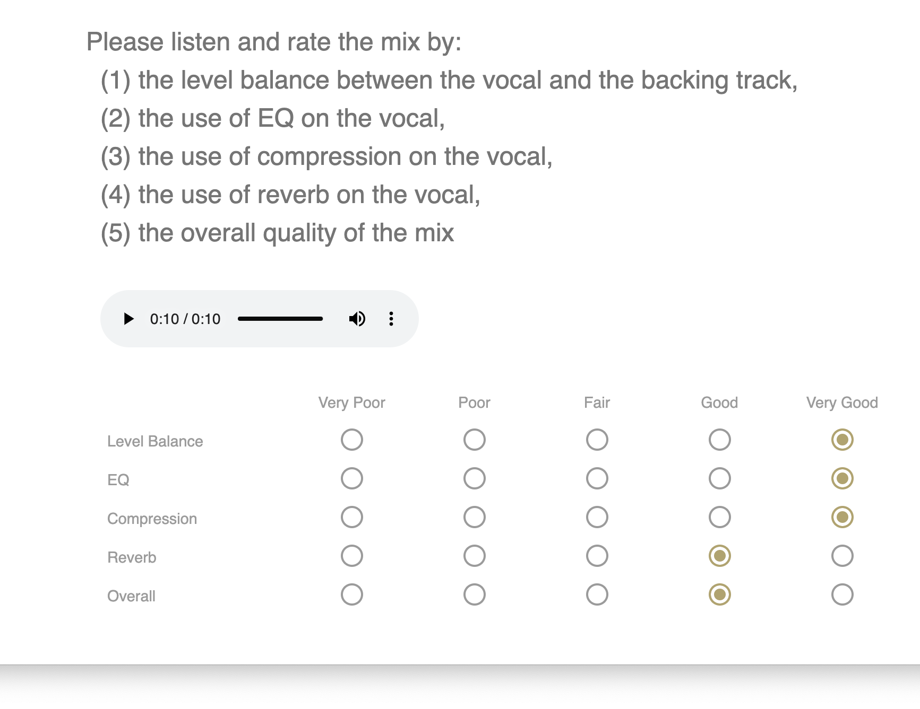
Listening Test

Slide 16

https://t.ly/0kur

